Slide 1
Fraud and Organizational Corruption

Slide 2
Learning Objectives
Understand the nature of fraud
Understand how fraud negatively impacts organizations
Define the various types of fraud
Understand how individuals become involved in fraud
Understand the fraud triangle
Understand how behavior changes can indicate fraud

Slide 3
What is Fraud?
Basically, there are two methods used to get something from others illegally.
Either you physically force someone to give you what you want (using a knife, other weapon, or brute force), or you trick them out of their assets.
The first type of theft we call robbery, the second type we call Fraud.
Robbery is generally more violent and more traumatic than fraud and attracts more media attention than fraud. However, losses from fraud far exceed losses from robbery.

Slide 4
Definition of Fraud
Fraud is a generic term, and embraces all the multifarious means which human ingenuity can devise, which are resorted to by one individual, to get an advantage over another by false representation. No definite and invariable rule can be laid down as a general proposition in defining fraud, as it includes surprise, trickery, cunning and unfair ways by which another is cheated. (Webster’s Dictionary, 1964)

Slide 5
Definition of Fraud
Fraud is different from unintentional errors (mistakes).
In order for fraud to occur, intentional deceit must occur.
If for example, someone mistakenly enters incorrect information on a financial statement, is this fraud?
However, if in the same situation, someone purposely enters incorrect numbers on a financial statement to trick investors - then it is Fraud!

Slide 6
Seriousness of Fraud
So, just how big of a problem is fraud?
The Association of Certified Fraud Examiners estimates that fraud cost organizations in the United States $400 billion annually.
It is estimated that an average organization’s fraud losses are more than $9 per employee per day (US).
Nearly five to seven percent of a company’s total annual revenue is lost to fraud of various types (US).

Slide 7
Who Commits Fraud?
What does a fraud perpetrator look like? Is it possible to identify fraudsters?
Studies have shown that fraud perpetrators look just like you and me.
In one study, fraud perpetrators were compared to college students and incarcerated prisoners.
The results showed that fraud perpetrators are very different than other incarcerated prisoners.
When compared to criminals they are less likely to be caught, turned in, arrested, convicted, and incarcerated.

Slide 8
Who Commits Fraud?
Fraud perpetrators were considerably older than other incarcerated prisoners.
Over 30 percent of fraud perpetrators were women. However, only 2 percent of incarcerated prisoners were women.
Fraud perpetrators were better educated, more religious, less likely to use drugs, and less likely to have criminal records.
Fraud perpetrators were in better psychological health and had better self-esteem.
They had more social conformity, self-control, kindness, and empathy.

Slide 9
What Does This Mean?
This means that we have to be especially careful in those whom we place trust.
The only people who can defraud us are those whom we put in a position of confidence.
Without our confidence we can not become victims of fraud.
Fraudsters are incredibly intelligent, able, and friendly people.
These are the people who we think would never do something to harm us.

Slide 10
Types of Fraud
Embezzlement
Employees take company assets
Vendor Fraud
Vendors take advantage of company
Customer Fraud
Customers take advantage of company
Management Fraud
Makes the company appear more profitable than it truly is (also known as Financial Statement Fraud)

Slide 11
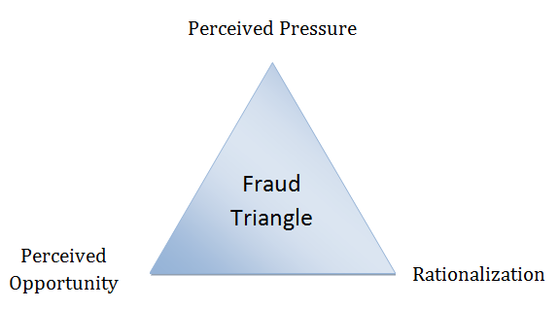
Fraud Triangle

Slide 12
Perceived Pressures
Pressures can be either financial or nonfinancial.
Nonfinancial pressures can be the need to report better results, frustration with work, or a challenge to “beat the system”.

Slide 13
Perceived Opportunity
Organizations can decrease perceived opportunities by creating an internal audit department, segregation of duties, and use a system of authorization.

Slide 14
Rationalization
Common rationalizations include:
“The organization owes me.”
“It’s for a good purpose.”

Slide 15
Detecting Fraud
Extravagant Lifestyle
While this provides only circumstantial evidence of fraud, it should still be a red flag.
Unusual Behavior
Fraud perpetrators may become irritable and confrontational or shy and reserved.
“I thought maybe what I was doing wasn’t wrong after all. So I decided to purchase a new car, stereo, and a new computer to use at home for work.”

Slide 16
YouTube Video
Was the Enron Scandal an isolated incident?

Slide 17
What do you think?
Was the Enron scandal one of a few bad apples? Or is the whole barrel of apples bad?
If there is a major problem, what can be done to combat this? Is taking a course on business ethics enough?

